Slide 1
LECTURE 4 DESCRIPTIVE STATISTICS: CENTRAL TENDENCY MEASURES
PSY2002
Hye Won Suk

Slide 2
DESCRIPTIVE STATISTICS
In this course we will learn the following three types of descriptive statistics.
Frequency distributions
Central tendency measures
Variability measures

Slide 3
CENTRAL TENDENCY
Frequency distributions are used to summarize and organize scores in a comprehensible way.
Another way to summarize and organize scores, perhaps the most commonly used way, is to find a single value that best represents all of the individuals scores in the distribution.
A central tendency measure (중심경향치) is a single value (a center) that is most typical or most representative of the entire set of scores.

Slide 4
MEASURES OF CENTRAL TENDENCY
There are various ways to define a center (the most representative value) of a distribution. The followings are the most commonly used central tendency measures.
Mean
Median
Mode

Slide 5
MEAN
The mean (평균), also known as arithmetic average (산술평균) is defined as the total divided by the number of scores.
The mean is calculated by adding all the scores in the distribution and dividing it by the number of scores.

Slide 6

POPULATION MEAN
Notation:
$$μ=\frac{\sum_{i=1}^{N}{X_{i}}}{N}$$
$N$: population size (number of persons in the population)
$μ$ : population mean; it is read “mu.”

Slide 7

SAMPLE MEAN
Notation:
$$\overline{X}=\frac{\sum_{i=1}^{n}{X_{i}}}{n}$$
$n$: sample size (number of persons in the sample)
$\overline{X}$: sample mean; it is read “X bar.”

Slide 8

AN EXAMPLE
Calculate the mean of the following scores in a sample:
1, 2, 6, 6, 10
$$\overline{X}=\frac{\sum_{i=1}^{n}{X_{i}}}{n}=\frac{1+2+6+6+10}{5}=\frac{25}{5}=5$$

Slide 9
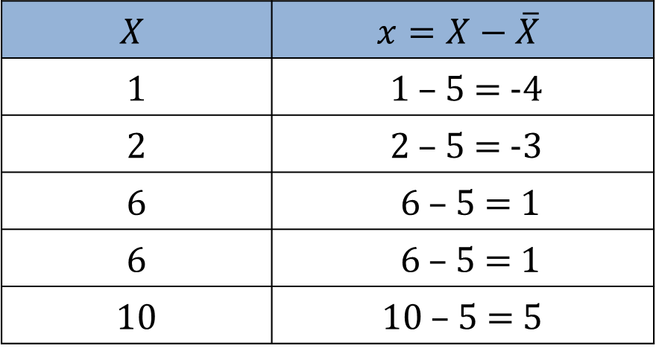

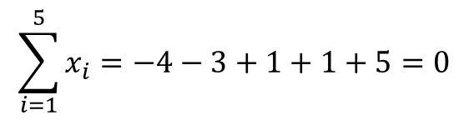
PROPERTIES OF THE MEAN
The sum of deviations from the mean across all persons = 0
Deviation from the mean
Population : $x_{i}=X_{i}−μ$
Sample : $x_{i}=X_{i}−\overline{X}$
$$X$$ | $$x=X−\overline{X}$$
1 | 1 – 5 = -4
2 | 2 – 5 = -3
6 | 6 – 5 = 1
6 | 6 – 5 = 1
10 | 10 – 5 = 5
$$\sum_{i=1}^{5}{x_{i}}=−4−3+1+1+5=0$$

Slide 10

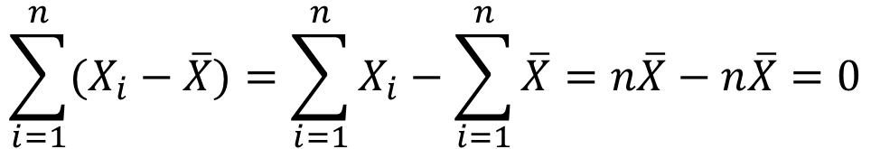

The sum of deviations from the mean is ALWAYS 0.
$$n\overline{X}=\sum_{i=1}^{n}{X_{i}}$$
$$\overline{X}=\frac{\sum_{i=1}^{n}{X_{i}}}{n}$$
$$\sum_{i=1}^{n}{(X_{i}−\overline{X})}=\sum_{i=1}^{n}{X_{i}}−\sum_{i=1}^{n}{\overline{X}}=n\overline{X}−n\overline{X}=0$$

Slide 11
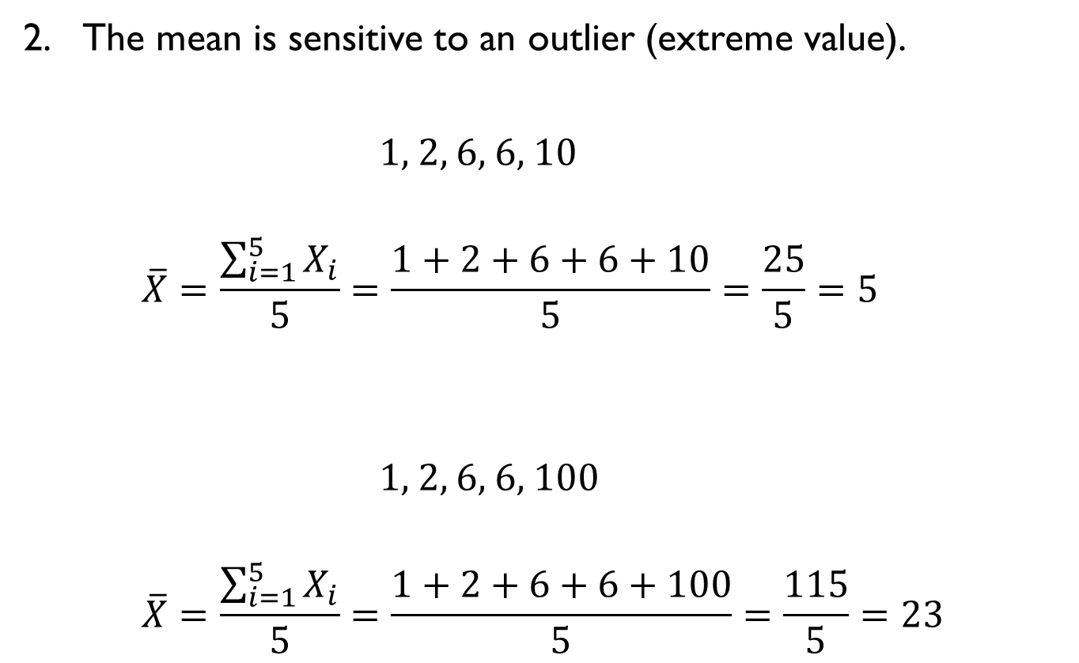
PROPERTIES OF THE MEAN
The mean is sensitive to an outlier (extreme value).
1, 2, 6, 6, 10
$$\overline{X}=\frac{\sum_{i=1}^{5}{X_{i}}}{5}=\frac{1+2+6+6+10}{5}=\frac{25}{5}=5$$
1, 2, 6, 6, 100
$$\overline{X}=\frac{\sum_{i=1}^{5}{X_{i}}}{5}=\frac{1+2+6+6+100}{5}=\frac{115}{5}=23$$

Slide 12
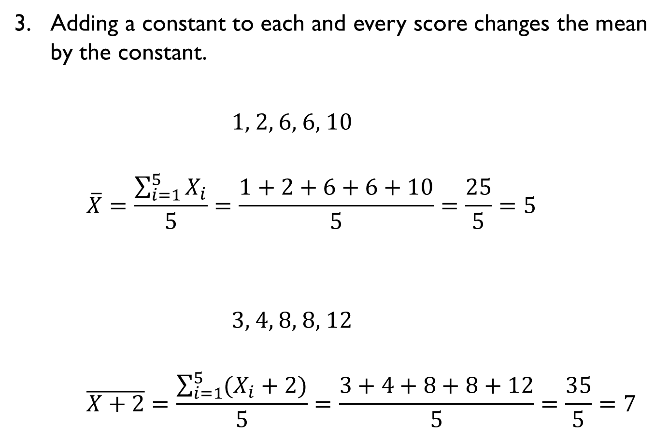
PROPERTIES OF THE MEAN
Adding a constant to each and every score changes the mean by the constant.
1, 2, 6, 6, 10
$$\overline{X}=\frac{\sum_{i=1}^{5}{X_{i}}}{5}=\frac{1+2+6+6+10}{5}=\frac{25}{5}=5$$
3, 4, 8, 8, 12
$$\overline{X+2}=\frac{\sum_{i=1}^{5}{(X_{i}+2)}}{5}=\frac{3+4+8+8+12}{5}=\frac{35}{5}=7$$
+2
+2

Slide 13

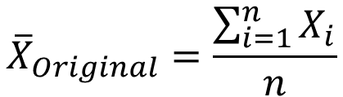
Adding a constant to each and every score:
Original mean:
Mean of the scores, each of which is added by a constant c :
$${\overline{X}}_{Original}=\frac{\sum_{i=1}^{n}{X_{i}}}{n}$$
$${\overline{X}}_{Adding a constant}=\frac{\sum_{i=1}^{n}{{(X}_{i}+c)}}{n}$$
$$=\frac{\sum_{i=1}^{n}{X_{i}}+\sum_{i=1}^{n}{c}}{n} \\ =\frac{\sum_{i=1}^{n}{X_{i}}}{n}+\frac{nc}{n} \\ ={\overline{X}}_{Original}+c$$

Slide 14
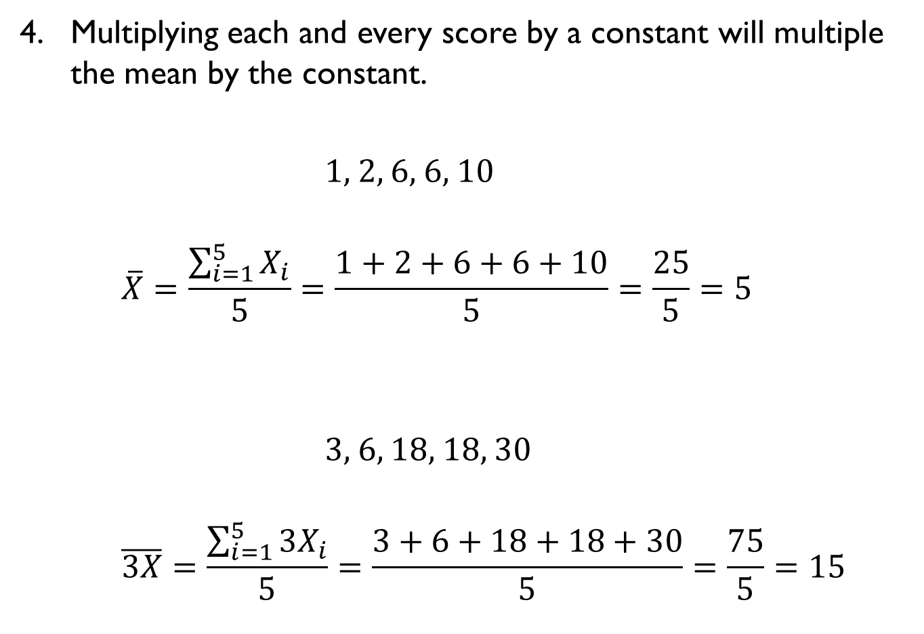
PROPERTIES OF THE MEAN
Multiplying each and every score by a constant will multiple the mean by the constant.
1, 2, 6, 6, 10
$$\overline{X}=\frac{\sum_{i=1}^{5}{X_{i}}}{5}=\frac{1+2+6+6+10}{5}=\frac{25}{5}=5$$
3, 6, 18, 18, 30
$$\overline{3X}=\frac{\sum_{i=1}^{5}{{3X}_{i}}}{5}=\frac{3+6+18+18+30}{5}=\frac{75}{5}=15$$
×3
×3

Slide 15

Adding a constant to each and every score:
Original mean:
Mean of the scores, each of which is multiplied by a constant c :
$${\overline{X}}_{Original}=\frac{\sum_{i=1}^{n}{X_{i}}}{n}$$
$${\overline{X}}_{Multiplying a constant}=\frac{\sum_{i=1}^{n}{{aX}_{i}}}{n}$$
$$=\frac{a\sum_{i=1}^{n}{X_{i}}}{n} \\ =a\frac{\sum_{i=1}^{n}{X_{i}}}{n} \\ =a{\overline{X}}_{Original}$$

Slide 16
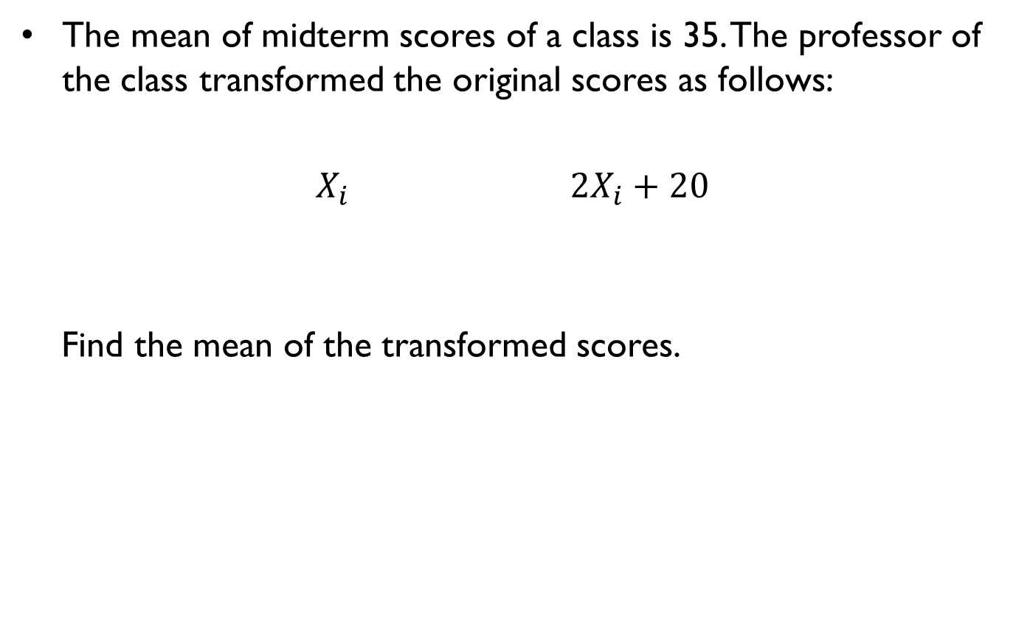
POP QUIZ
The mean of midterm scores of a class is 35. The professor of the class transformed the original scores as follows:
$X_{i}$ $2X_{i}+20$
Find the mean of the transformed scores.

Slide 17
SCALE OF MEASUREMENT
Can we obtain the mean of scores measured on a nominal scale or ordinal scale?
Female, Male, Male, Female, Female, Male, Male, Male, Male
A+, A, A, B+, B, C+, A+, A, B

Slide 18
MEDIAN
The median (중앙값) is the score in the middle of the distribution when the scores are sorted in order from smallest to largest.
The median divides the distribution exactly in half. 50% of the scores are below the median and the other 50% are above the median.

Slide 19
MEDIAN
How to find the median of a set of scores?
4, 7, 3, 5, 10, 3, 9
Step1. Sort the scores in order from lowest to highest:
3, 3, 4, 5, 7, 9, 10
Step 2. Find the score in the middle ==> 5

Slide 20
MEDIAN
What if we have an even number of scores?
4, 7, 3, 5, 10, 3, 9, 12
Step 1: Sort the scores in order from lowest to highest:
3, 3, 4, 5, 7, 9, 10, 12
Step 2: Find the two scores in the middle: 5 and 7
Step 3: Calculate the mean of the two scores: (5 + 7)/2 = 6

Slide 21
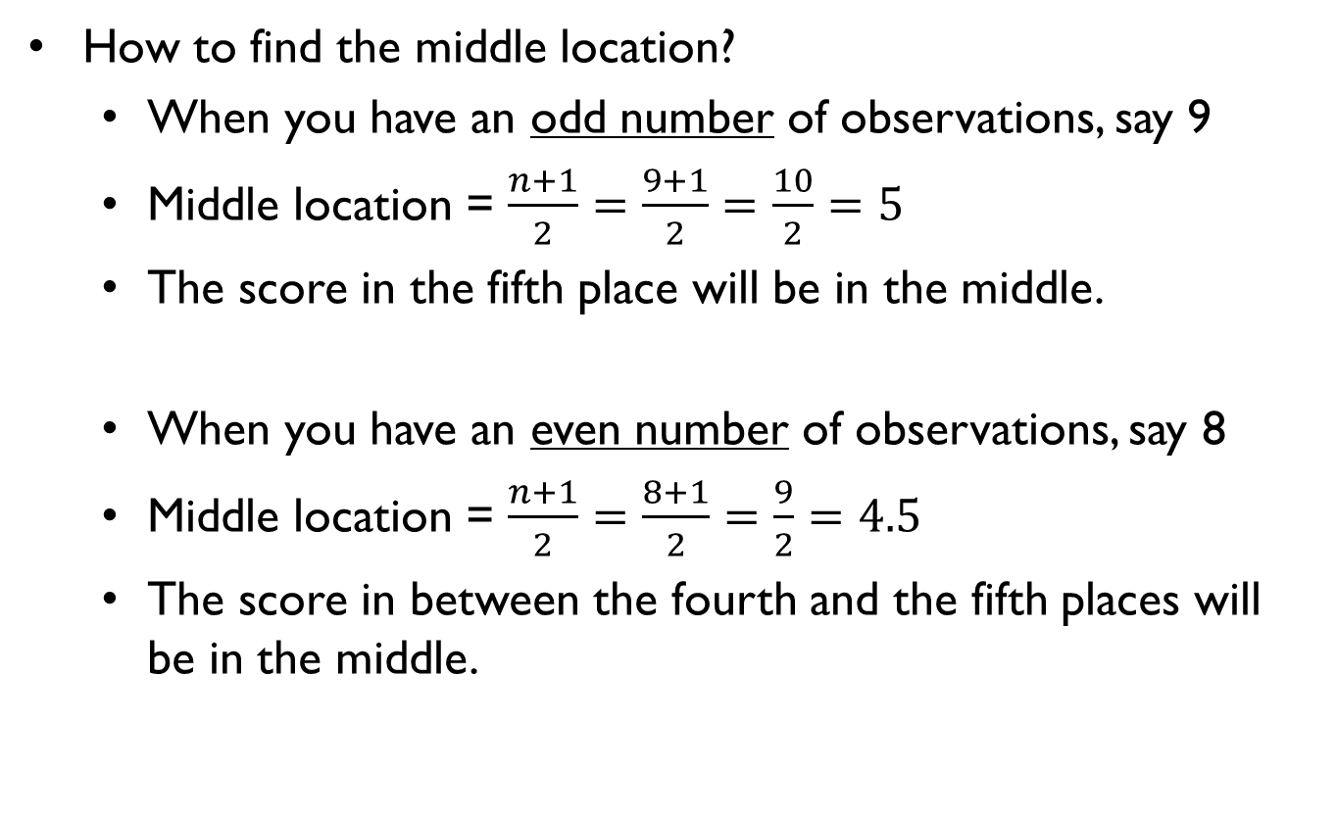
MEDIAN
How to find the middle location?
When you have an odd number of observations, say 9
Middle location = $\frac{n+1}{2}=\frac{9+1}{2}=\frac{10}{2}=5$
The score in the fifth place will be in the middle.
When you have an even number of observations, say 8
Middle location = $\frac{n+1}{2}=\frac{8+1}{2}=\frac{9}{2}=4.5$
The score in between the fourth and the fifth places will be in the middle.

Slide 22
PROPERTIES OF THE MEDIAN
What happens to the median if we have outliers (extreme values)?
1, 2, 2, 3, 5, 8, 8, 10, 12
Median = 5
1, 2, 2, 3, 5, 8, 8, 100, 120
Median = 5
-100, -50, 2, 3, 5, 8, 8, 100, 120
Median = 5
Median is not sensitive to outliers.

Slide 23
SCALE OF MEASUREMENT
Can we obtain the median of scores measured on a nominal or ordinal scale?
Female, Male, Male, Female, Female, Male, Male, Male, Male
A+, A, A, B+, B, C+, A+, A, B

Slide 24
MODE
The mode (최빈치) is defined as the most frequent score in the distribution.
To find the mode, look for the most frequent score in the frequency table or in the frequency graph.
Mode = Brown
X (hair color) | f
Black | 4
Blond | 3
Brown | 13
Red | 4

Slide 25
MODE
The mode may not be unique.
When there are two modes, the distribution is termed bimodal.
When there are multiple modes, the distribution is termed multimodel.
Mode = 1, 5 (bimodal)
X | f
1 | 4
2 | 3
3 | 1
4 | 2
5 | 4

Slide 26
SCALE OF MEASUREMENT
Can we obtain the mode of scores measured in a nominal or ordinal scale?
Female, Male, Male, Female, Female, Male, Male, Male, Male
A+, A, A, B+, B, C+, A+, A, B

Slide 27
SCALE OF MEASUREMENT
Scale of measurement | Mean | Median | Mode
Nominal | X | X | O
Ordinal | X | ∆ | O
Interval | O | O | O
Ratio | O | O | O

Slide 28
MEAN vs. MEDIAN
For interval/ratio variables, the mean is the most frequently used central tendency measure.
However, the median is more preferred to the mean for the following cases:
When the distribution of scores is markedly skewed
When the sample size is small and there is an outlier (extreme score that is far away from the other scores)
In general, it is recommended to report both the mean and median.

Slide 29
EXAMPLE
Pedersen et al. (2002). Psychological Science
“Evolved Sex Differences in the Number of Partners Desired? The Long and the Short of It”
A total of 266 undergraduate students at the University of Southern California (107 men and 159 women) participated.
Participants estimated how many sexual partners they would “ideally” like to have over the next 30 years.

Slide 30
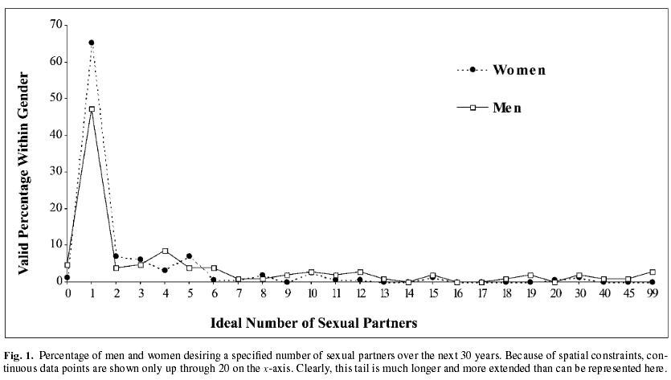
EXAMPLE

Slide 31
EXAMPLE
Do young men and women differ in the preferred number of sex partners over the next 30 years?
For men, the mean = 7.69
For women, the mean = 2.78
A huge difference between men and women.
For men, the median = 1
For women, the median = 1
No difference!

Slide 32
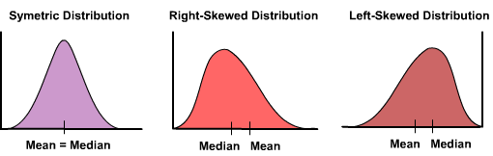
SKEWED DISTRIBUTION
For a skewed distribution, the mean might be a poor index of central tendency.

Slide 33
SUMMARY
Three central tendency measures and their properties
Mean
Median
Mode
Depending on the scale of measurement and the shape of the distribution of the scores, you need to choose appropriate central tendency measures to use.

